Slide 1
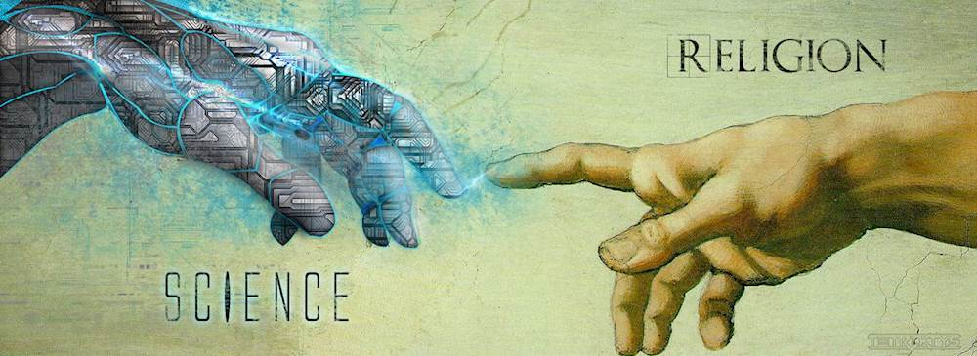
Science and Religion

Slide 2
Who are you?
From a scientific lens, what can science reveal to you who you are?
From a religious lens, what can religion reveal to you who you are?
Notes:
Ask students these two questions and have them display this on the nearpod/whiteboard
Go through each claim→ Is this testable?

Slide 3
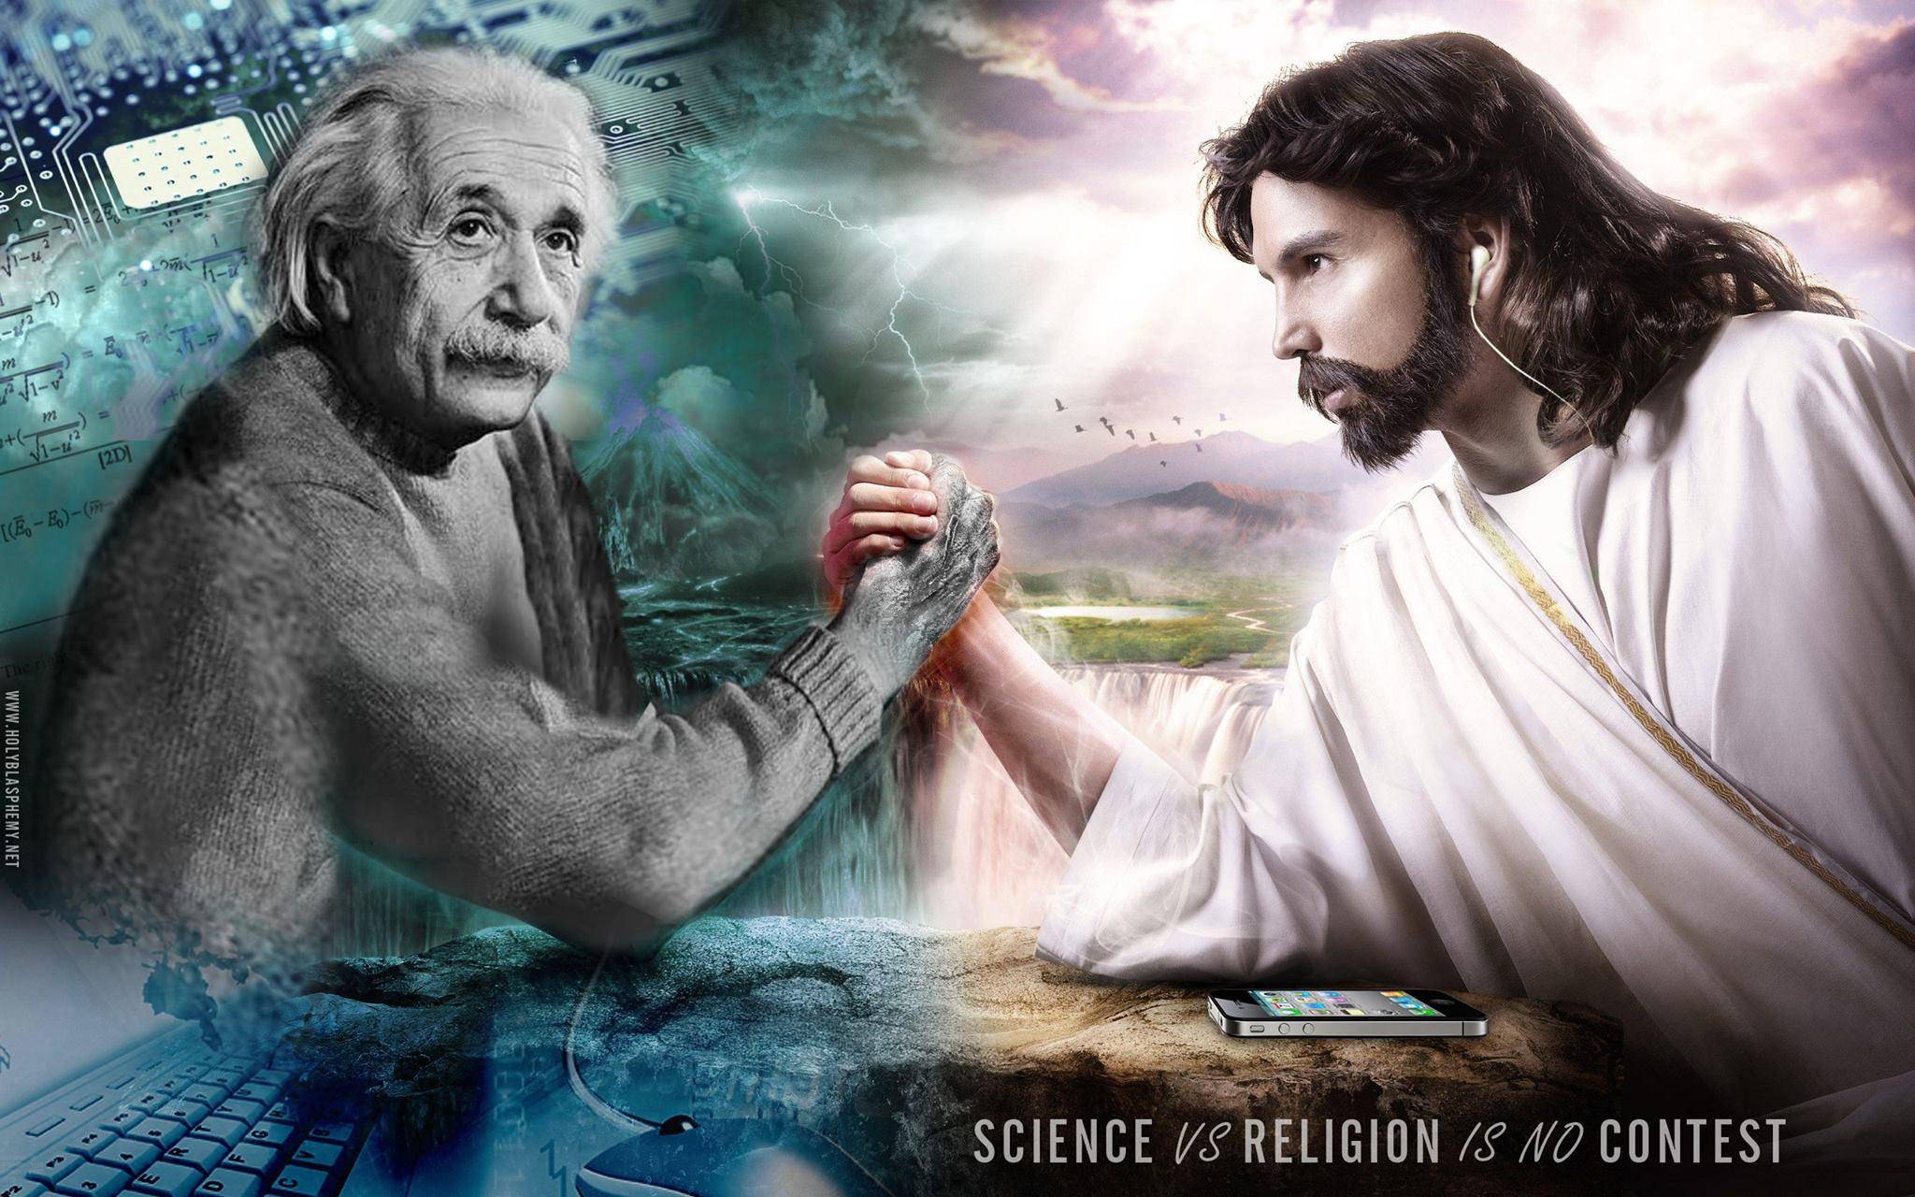
Essential Questions
Are Science and Religion at odds?
What is the Catholic Church's stance on evolution?
Has Science disproved God?
Is Revelation (Sacred Scripture and Sacred Tradition) Anti-Science? Is the Catholic Church Anti-Science?
Are all Scientists Atheists?

Slide 4
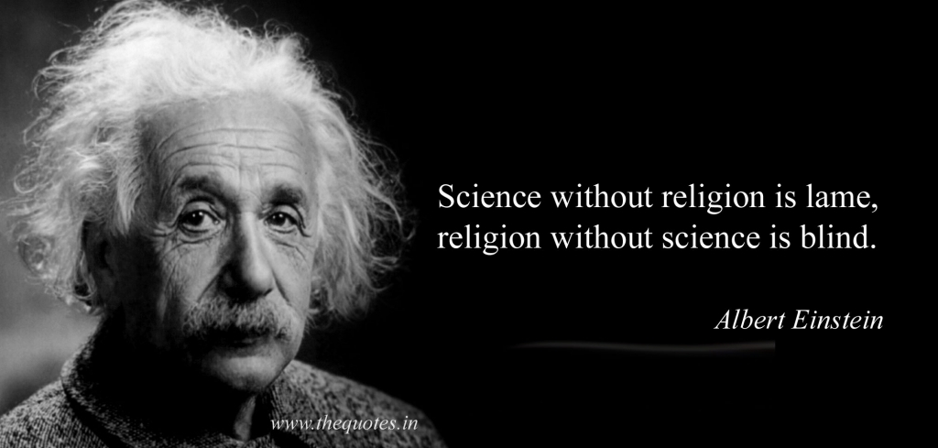
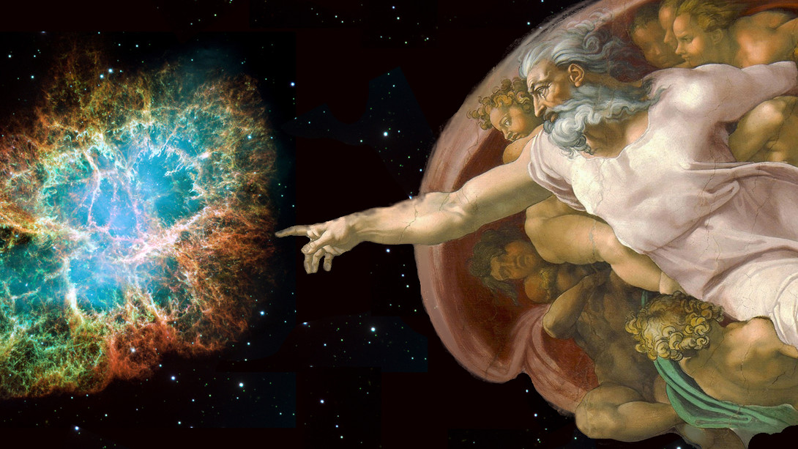
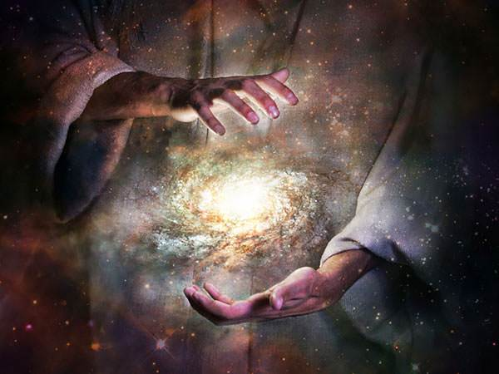
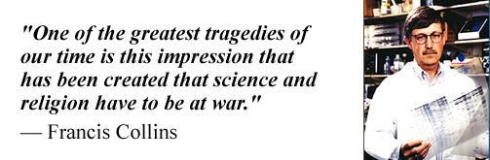

Slide 5
The Beginning and Creation of the Universe
Gen 1:1 "In the beginning, God created the heavens and the earth”
Creation- refers to the fact that the universe depends for its existence upon God, who is the source of its being
Beginning refers to the universe having a temporal starting point rather than having a history that stretches infinitely into the past of that goes around in a loop
"Time is an aspect of created world. And so time itself is something created. If time is passing something created already exists, creation has taken place
Time is a measure of change- Time therefore is something created.
Time is only there if something is already created.
~Dr. Stephen Barr, summer 2019, Notre Dame Foundations
Notes:
Dr. Stephen Barr

Slide 6
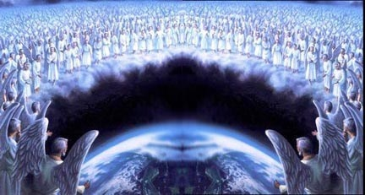
The Creation of the World (Genesis 1)
1 In the beginning, God created the heavens and the earth. ² The earth was without form and void, and darkness was over the face of the deep. And the Spirit of God was hovering over the face of the waters.
³ And God said, “Let there be light,” and there was light. ⁴ And God saw that the light was good. And God separated the light from the darkness.⁵ God called the light Day, and the darkness he called Night. And there was evening and there was morning, the first day.

Slide 7
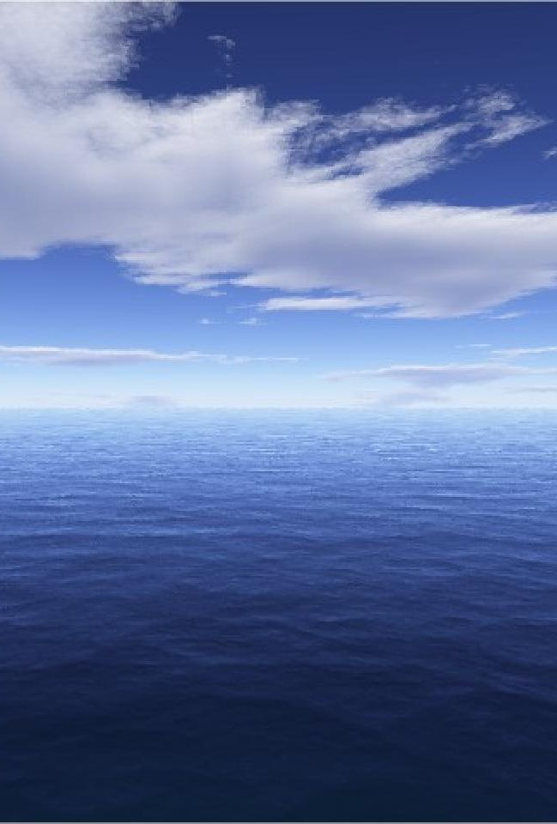
The Creation of the World (Genesis 1)
⁶ And God said, “Let there be an expanse^{[a]} in the midst of the waters, and let it separate the waters from the waters.” ⁷ And God made^{[b]} the expanse and separated the waters that were under the expanse from the waters that were above the expanse. And it was so. ⁸ And God called the expanse Heaven.^{[c]} And there was evening and there was morning, the second day.
⁹ And God said, “Let the waters under the heavens be gathered together into one place, and let the dry land appear.” And it was so. ¹⁰ God called the dry land Earth,^{[d]} and the waters that were gathered together he called Seas. And God saw that it was good.

Slide 8
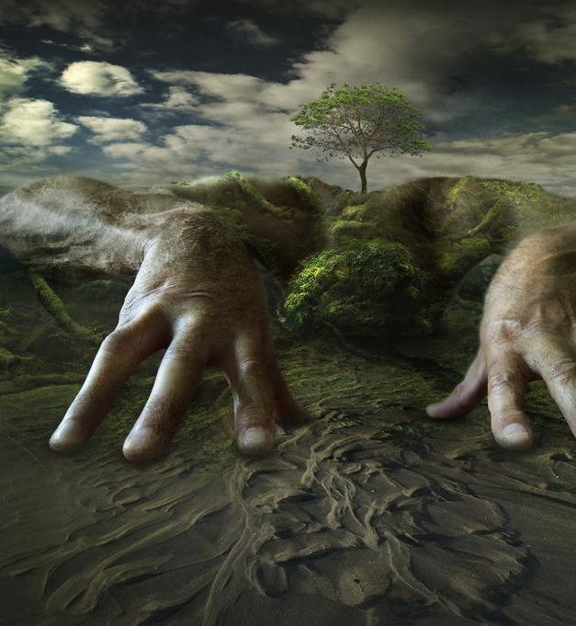
The Creation of the World (Genesis 1)
¹¹ And God said, “Let the earth sprout vegetation, plants^{[e]} yielding seed, and fruit trees bearing fruit in which is their seed, each according to its kind, on the earth.” And it was so. ¹² The earth brought forth vegetation, plants yielding seed according to their own kinds, and trees bearing fruit in which is their seed, each according to its kind. And God saw that it was good. ¹³ And there was evening and there was morning, the third day.

Slide 9

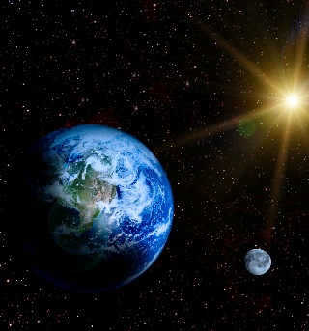
The Creation of the World (Genesis 1)
¹⁴ And God said, “Let there be lights in the expanse of the heavens to separate the day from the night. And let them be for signs and for seasons,^{[f]} and for days and years, ¹⁵ and let them be lights in the expanse of the heavens to give light upon the earth.” And it was so.¹⁶ And God made the two great lights—the greater light to rule the day and the lesser light to rule the night—and the stars. ¹⁷ And God set them in the expanse of the heavens to give light on the earth, ¹⁸ to rule over the day and over the night, and to separate the light from the darkness. And God saw that it was good. ¹⁹ And there was evening and there was morning, the fourth day.

Slide 10
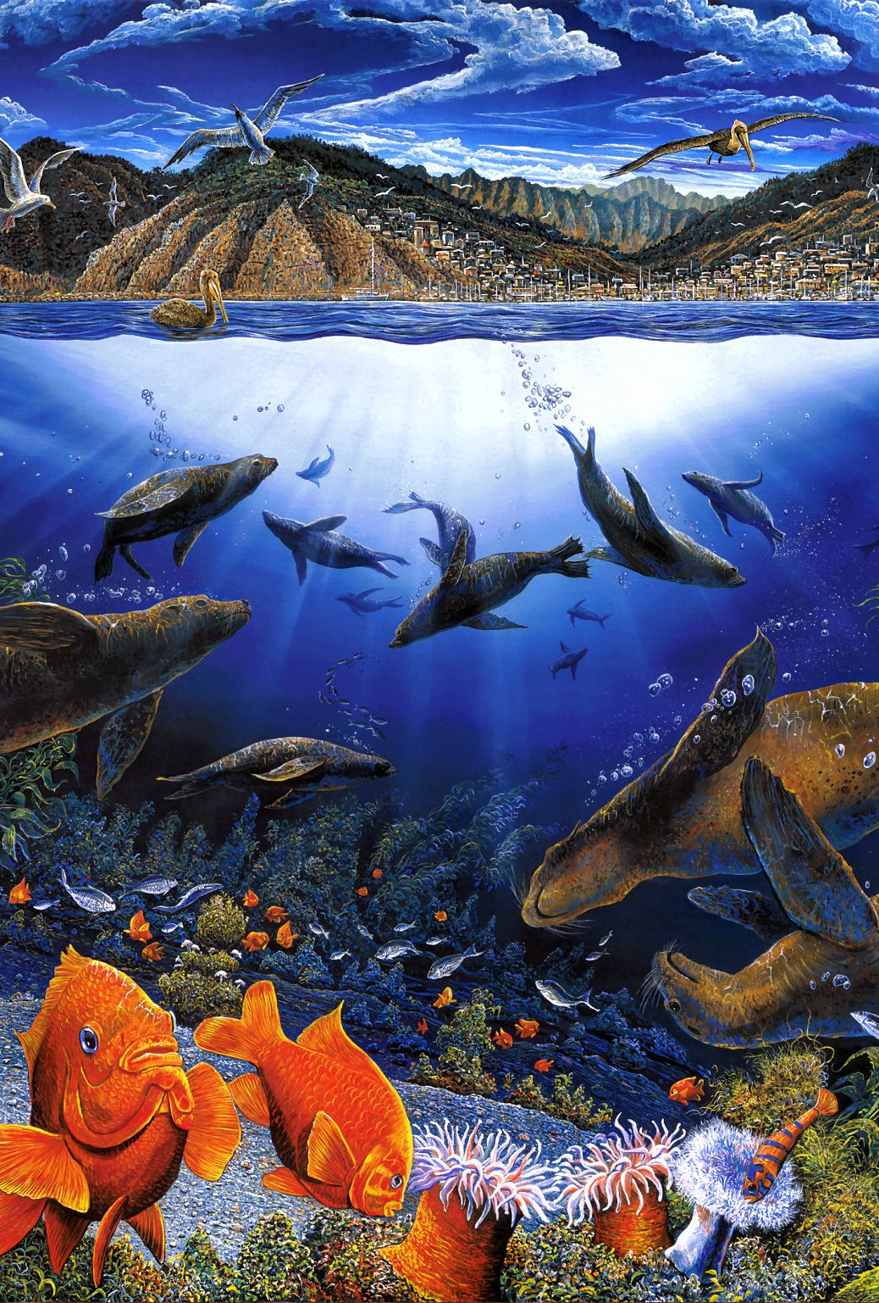
The Creation of the World (Genesis 1)
²⁰ And God said, “Let the waters swarm with swarms of living creatures, and let birds^{[g]} fly above the earth across the expanse of the heavens.”²¹ So God created the great sea creatures and every living creature that moves, with which the waters swarm, according to their kinds, and every winged bird according to its kind. And God saw that it was good.²² And God blessed them, saying, “Be fruitful and multiply and fill the waters in the seas, and let birds multiply on the earth.” ²³ And there was evening and there was morning, the fifth day.
²⁴ And God said, “Let the earth bring forth living creatures according to their kinds—livestock and creeping things and beasts of the earth according to their kinds.” And it was so. ²⁵ And God made the beasts of the earth according to their kinds and the livestock according to their kinds, and everything that creeps on the ground according to its kind. And God saw that it was good.

Slide 11
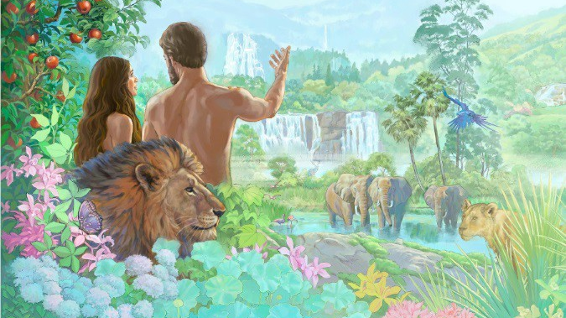
The Creation of the World (Genesis 1)
²⁶ Then God said, “Let us make man^{[h]} in our image, after our likeness. And let them have dominion over the fish of the sea and over the birds of the heavens and over the livestock and over all the earth and over every creeping thing that creeps on the earth.”
²⁷ So God created man in his own image, in the image of God he created him; male and female he created them.

Slide 12
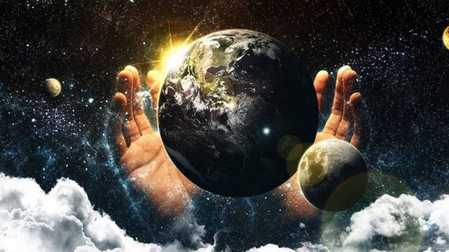
²⁸ And God blessed them. And God said to them, “Be fruitful and multiply and fill the earth and subdue it, and have dominion over the fish of the sea and over the birds of the heavens and over every living thing that moves on the earth.” ²⁹ And God said, “Behold, I have given you every plant yielding seed that is on the face of all the earth, and every tree with seed in its fruit. You shall have them for food. ³⁰ And to every beast of the earth and to every bird of the heavens and to everything that creeps on the earth, everything that has the breath of life, I have given every green plant for food.” And it was so. ³¹ And God saw everything that he had made, and behold, it was very good. And there was evening and there was morning, the sixth day.

Slide 13
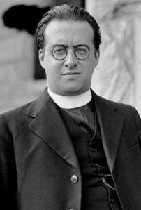
George Lemaitre- The Big Bang Theory (1894-1966)
Monsignor Georges Lemaître was a Belgian Roman Catholic priest, physicist and astronomer.
He is credited with the first definitive formulation of the idea of an expanding universe and what was to become known as the Big Bang theory of the origin of the universe.

Slide 14
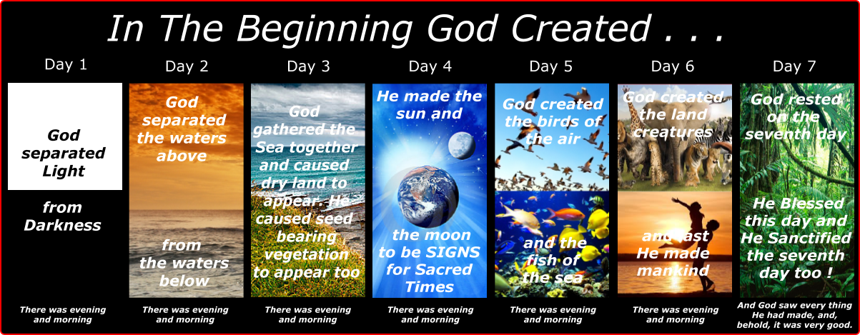
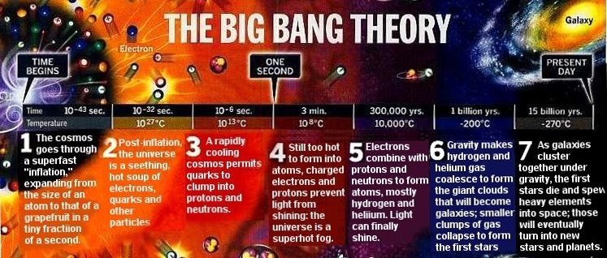
Can then the interpretation of chronology that God created the universe be more metaphorical than literal?

Slide 15
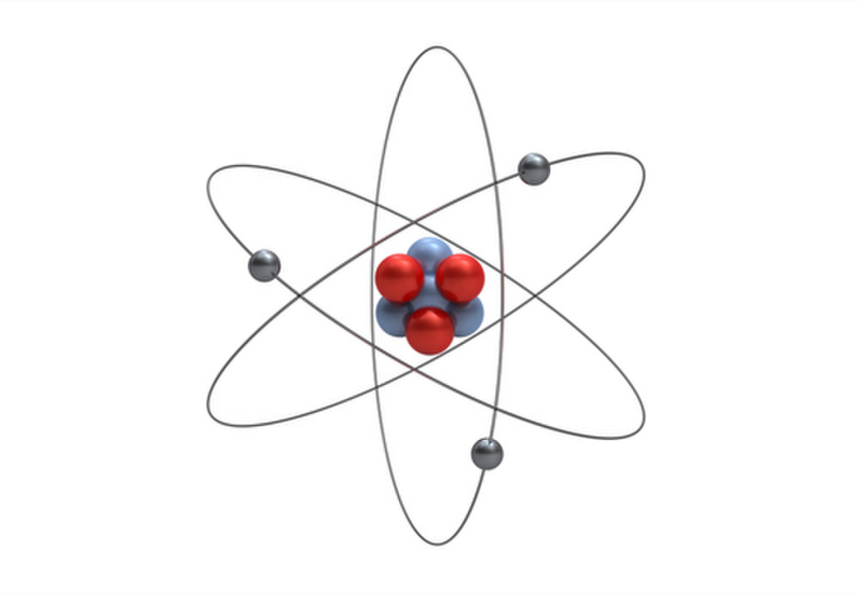
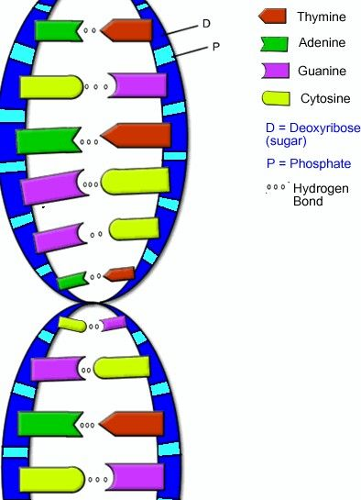
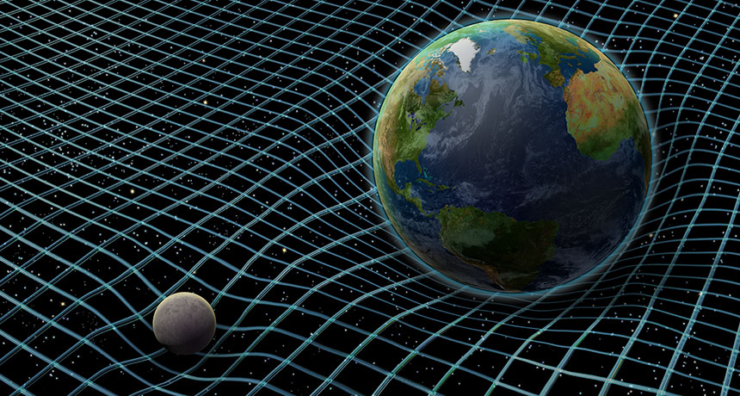
Literal Vs. Metaphorical Interpretations
In Science we use metaphors (or analogies) all the time
Examples include models and images to explain or visualize theories
Notes:
In Science we use metaphors all the time; The Atom, DNA, Gravity Spacetime are all models

Slide 16
How Science and Religion are similar?
Scientific Inquiry & The Scientific Method
Religious Belief
In all fields of Science everything begins with a question, usually through some sort of observation
Scientists then will postulate hypothesis (or theories), which they HOPE can be proven through experimentation
Scientists then create laws through these experiments
Historically:
“Philosophy” (the love of wisdom) included the natural sciences (e.g. Ancient Greece; Medieval Europe)
“Theology” (the study of God/reflection about God) addressed more specific ultimate and metaphysical questions not demonstrable in the same way as scientific fact
Through the medieval period, knowledge about the natural world and theological knowledge influenced one another; they were considered to be in a coherent unity
Similarly, the current dominant Catholic perspective understands science and religion as two perspectives exploring God’s revelation; not mutually exclusive but informing and purifying one another from error and idolatry
It is hope (faith) and the search for meaning that binds both science and religion

Slide 17
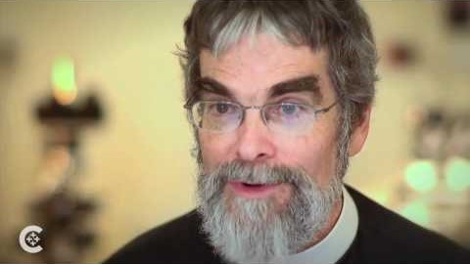

Slide 18
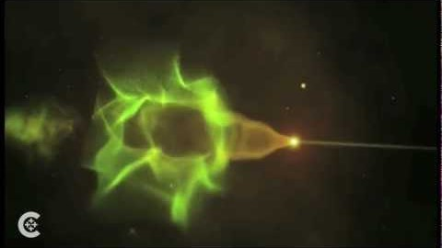

Slide 19
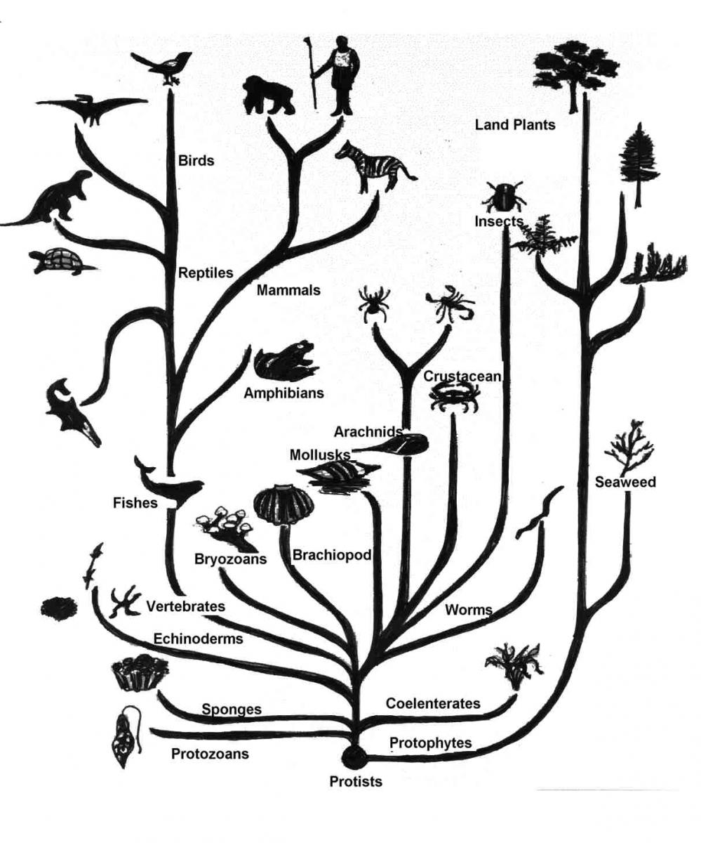
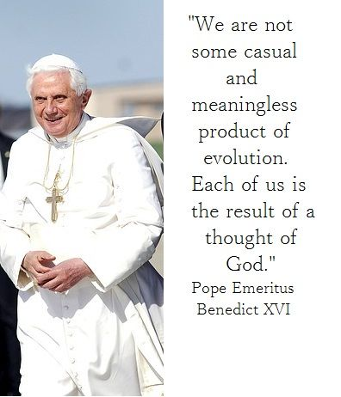
The Catholic Church’s view on Evolution
https://www.usnews.com/news/articles/2014/10/28/pope-francis-comments-on-evolution-and-the-catholic-church

